Slide 1
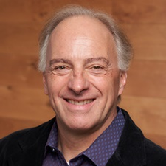
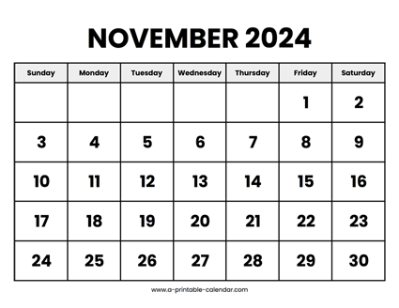
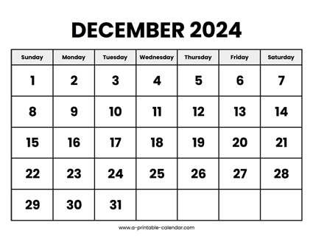

CS 310 : Scalable Software Architectures
Week 09 (Nov 18 – Nov 22)
This week in CS 310:
Focus this week:
Distributed systems, CAP theorem
Security and authentication
Project 03 is finishing up…
Project 04 will be released later this week
What's left?
Final project proposals due Tuesday 11/19
Exam 02 on Tuesday 12/03
Final project due Friday 12/06
Project 04 due Friday 12/13 (finals week)

Slide 2
Topics
Distributed systems
Types of consistency
CAP theorem
Security
Authentication
Users, roles, pwds, https

Slide 3
Class sessions
Tuesday:
No class
Thursday:
Let's plan to meet

Slide 4
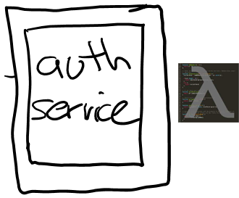
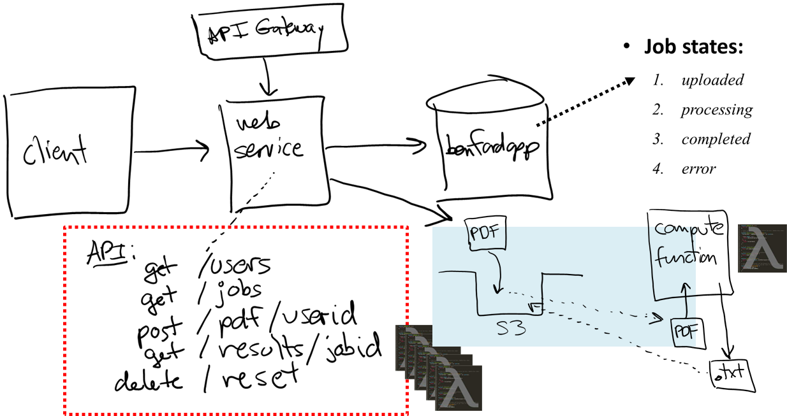
Project 04
Project 04 adds authentication (users & pwds)

Slide 5




Project 04
Project 04 adds authentication (users & pwds)

